Slide 1
Dial100.com
Presented by :
Ajith And Mayuri

Slide 2
Index
Introduction
Objective
Software requirements
Process of Dial100.com
Advantages
Disadvantages
Conclusion

Slide 3
Dial1100.com
Citizens can quickly and easily report crimes or suspicious activities online, without needing to visit a police station.
The portal is available 24/7, allowing users to file reports at any time, ensuring that incidents are logged immediately.
All crime reports and related evidence are securely stored in a digital format, reducing the risk of loss or tampering with physical documents.

Slide 4
Objective
Develop an efficient online platform for reporting crimes.
Provide a user-friendly interface for citizens to report incidents.
Facilitate tracking of reported incidents for transparency and
accountability.
Allow users to follow up on reports and receive updates.
Provide access to relevant safety information for users.

Slide 5
Software Requirements
HTML ( Hypertext Markup Language )
CSS ( Cascading Style Sheets )
ReactJs
Java
Spring Boot
MySQL (Database)

Slide 6
Process Of dial100.com
Plaintiff Registration/Login: Plaintiff sign up or log in to access the portal.
Crime Reporting: Plaintiff submit details of the crime or incident.
Report Validation: System verifies the completeness and authenticity of the report.
Law Enforcement Response: Authorities review and take action on the report.
Plaintiff Follow-Up: Plaintiff can track the status and receive updates on their reports.
Closure: Cases are closed once resolved.

Slide 7
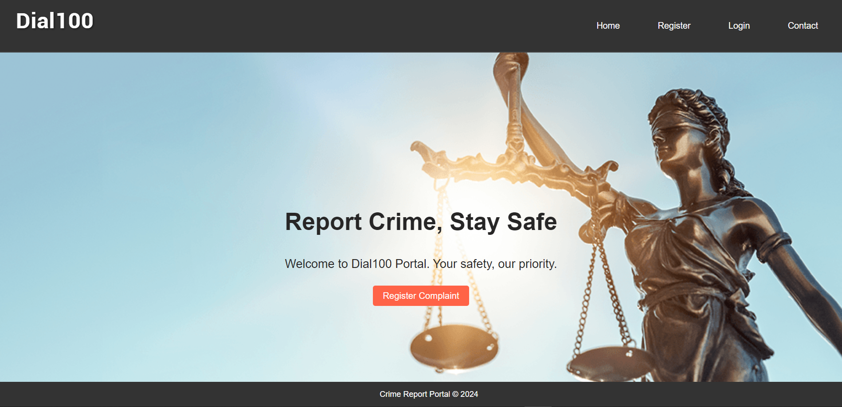
Home Page:

Slide 8
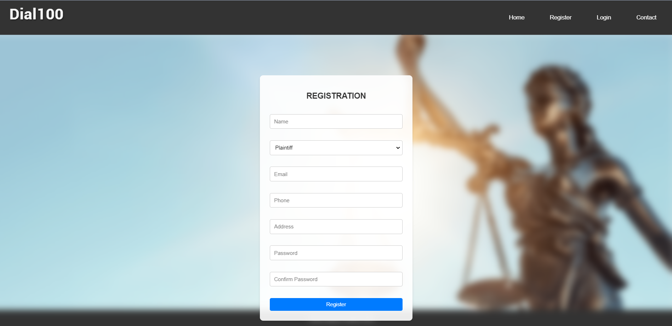
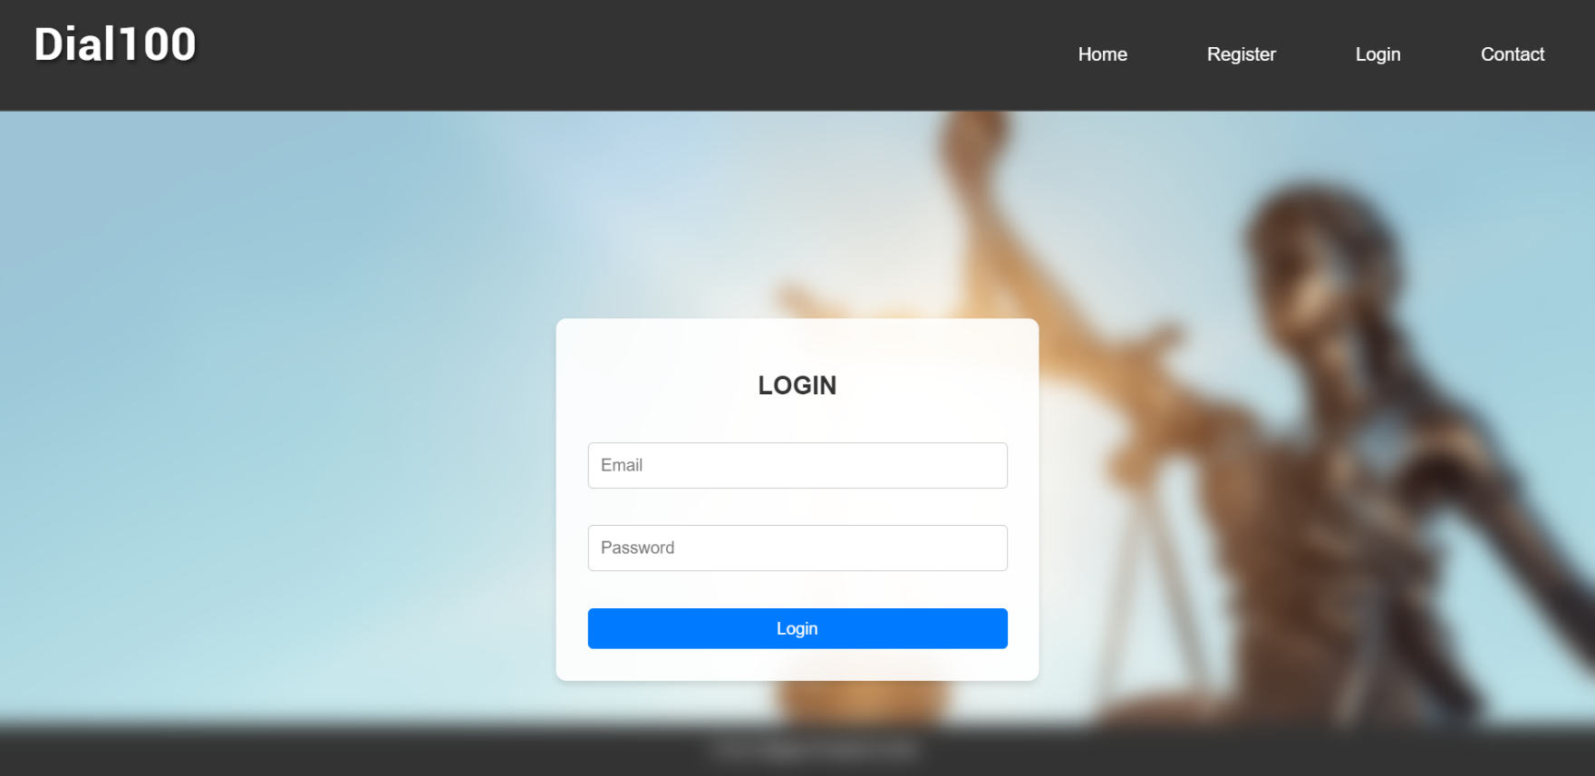
Register and Login Page:

Slide 9
Future of Dial100.com
Mobile App Expansion: Development of a mobile app for easier and faster crime reporting.
Multilingual Support: Inclusion of support for multiple languages to cater to a diverse population.
Collaboration with Social Media: Integration with social media platforms for quick dissemination of alerts and updates.
Enhanced Security Features: Improved encryption and data protection measures to ensure user privacy and system security.
Public Awareness Campaigns: Ongoing initiatives to educate the public about the platform and encourage its use.

Slide 10
Advantages of dial100.com
Increased Accessibility: Provides a convenient platform for everyone to access law enforcement services.
Transparency: Users can track the status of their reports, ensuring transparency and accountability.
Cost-Effective: Reduces the need for physical police presence for minor incidents, saving costs.
Community Engagement: Strengthens community-police relations by providing a direct and open communication channel.

Slide 11
Disadvantages oF dial100.com
Digital Divide: Limited access for people without internet or tech-savvy skills.
False Reports: Risk of receiving fake or misleading crime reports.
Data Privacy Concerns: Potential risks related to the handling and security of sensitive user information.
Limited Physical Presence: Reduced face-to-face interaction with law enforcement might affect the thoroughness of some investigations.

Slide 12
conclusion
The Dial100.com Crime Report Portal successfully creates a streamlined, accessible, and transparent platform for citizens to report crimes and engage with law enforcement. By leveraging technology, the portal enhances the efficiency of emergency responses, improves community safety, and fosters trust between the public and law enforcement agencies.

Slide 13
Thank You…

